Slide 1
GEORGIAN COLLEGE | AI STRATEGY AND CHANGE
Manufacturing Planning Agent
Spot material shortages earlier and give production planners clearer options to help avoid delays.
Mary Chlouie Padios | LIAI – Strategy and Change

Slide 2
CHALLENGE CONTEXT
The Problem: Latent Shortages and Manual Review
Current Planning Routine
Production planners review production orders, inventory records, and delivery deadlines across disparate sources to identify potential schedule problems.
The Manual Checking Bottleneck
When information is checked manually, material shortages may be discovered late. Consequently, operations and procurement teams have significantly less time to coordinate an effective response.
Business Impact to Validate
Key operational liabilities to measure and validate during assessment:
• Excessive manual checking and cross-referencing time
• High schedule disruption across assembly lines
• Escalated downstream delivery and handover risk
LIAI – Strategy and Change | 02 / 10

Slide 3
SOLUTION RATIONALE
Why an Agent? Connecting Multi-Step Reasoning
Beyond Static Calculation
A simple static rule can calculate a basic shortage (Required − Available = Shortage). However, production environments require context-aware orchestration across fragmented data points.
The Manufacturing Planning Agent connects several critical analytical steps into a continuous workflow rather than isolated queries.
Agent Workflow & System of Record
1. Validate Data — checks integrity and completeness of records
2. Check Material Availability — reconciles stock & incoming POs
3. Identify Deadline Risks — evaluates buffer against schedule
4. Explain Findings — presents plain-language operational summaries
5. Present Recommendations — proposes mitigation alternatives
Core Authority Principle:
The AI helps with analysis and communication; source records (ERP/MES) remain the sole authority for quantities and deadlines.
LIAI – Strategy and Change | 03 / 10

Slide 4
SYSTEM ARCHITECTURE
Solution Concept: Architecture and Workflow Flow
1. Input Trigger
USER REQUEST / NEW DATA
Production orders, live inventory telemetry, schedule updates
2. Orchestrator
MANUFACTURING PLANNING AGENT
Receives input, coordinates execution context
3. Core Checkers
DATA VALIDATION
SHORTAGE CHECKER
DEADLINE-RISK CHECKER
4. Recommendation
OPENAI API RECOMMENDATION
(When configured)
Generates mitigation options
5. Review Interface
DASHBOARD / RESPONSE MESSAGE
Structured operational review for Human Planner
Strict Governance Rule: Human Planner in the Loop
No unapproved operational changes. The agent operates strictly as an advisory system providing structured decision support.
LIAI – Strategy and Change | 04 / 10

Slide 5
WORKFLOW COMPARISON
User Journey: Before and After Implementation
BEFORE: Manual Investigation
• Planner manually compares production orders against inventory sheets.
• Must manually investigate whether an order could be delayed.
• Information is fragmented across records, leading to delayed discovery.
• Time-consuming manual email and phone coordination.
AFTER: Unified Agent-Assisted Check
• Planner runs an automated check in seconds.
• Immediately views material, required quantity, available quantity, shortage, deadline, and recommended next steps in one unified screen.
• Clear visibility allows rapid, proactive coordination before lines stall.
Illustrative Operational Scenario
Example Case: Production order requires 120 Connector-X | Current available inventory: 75 | Calculated shortage: 45 units.
Agent identifies the 45-unit gap against the assembly schedule and recommends evaluated sourcing or shift-allocation options for planner review.
LIAI – Strategy and Change | 05 / 10

Slide 6
VALUE & MEASUREMENT
Value and Proposed KPIs: Pilot Performance Metrics
Shortage-Check Time
30% Lower
Compared to current baseline checking duration
Detection Accuracy
≥ 95%
Evaluated on a verified operational test set
Recommendation Usefulness
70%
Initial target of reviewed recommendations rated valuable
Human Approval Compliance
100%
Strict enforcement before any important changes
Proposed Pilot Targets, Not Proven Results: Measure a verified baseline before claiming impact.
LIAI – Strategy and Change | 06 / 10

Slide 7
RISK & GOVERNANCE
Risks and Guardrails: Safe Deployment Architecture
Identified Operational Risks
• Inaccurate or Stale Records: Bad inventory or order data produces misleading calculations.
• Incorrect AI Suggestions: Algorithmic recommendations may not fit floor constraints.
• API & Service Failure: System downtime could halt decision support.
• Privacy and Security Risks: Exposing proprietary bill-of-materials or vendor pricing.
• Automation Bias: Planners blindly accepting recommendations without verification.
Implemented System Guardrails
• Show Source Values: Always display original input values alongside calculated shortages.
• Clarify Missing Inputs: Explicitly prompt and ask when data is missing or unclear.
• Separate Facts from AI: Clearly label AI recommendations separately from verified facts.
• Mandatory Human Approval: Require human planner approval before important changes.
• Hard Safety Boundaries: Never invent approved substitutes or update live systems automatically.
LIAI – Strategy and Change | 07 / 10

Slide 8
ORGANIZATIONAL ADOPTION
Change Management: Adoption and Organizational Support
Affected User Groups and Stakeholders
Production Planners • Materials & Inventory Staff • Purchasing / Procurement • Quality Assurance • Production Supervisors • IT & Security
User Adoption & Enablement
• Involve end-users actively in testing from early prototype stages.
• Conduct hands-on training using familiar, historical production cases.
• Establish active feedback loops to tune recommendations.
• Clarify responsibilities and define sign-off authority clearly.
Strategic AI Positioning
• Decision Support: Position the agent as an operational co-pilot that assists rather than replaces human staff.
• Complement Human Expertise: Augment planners' manufacturing experience with rapid, data-backed synthesis.
• Build Trust Gradually: Demonstrate reliable recommendations before expanding scope.
LIAI – Strategy and Change | 08 / 10

Slide 9
IMPLEMENTATION ROADMAP
Roadmap: Phased Implementation and Governance Gates
PHASE 1: PROTOTYPE
Demonstrate sample data checks, shortage analysis, recommendations, and human review.
GATE 1 CRITERIA:
Key test cases work reliably and operational limitations are documented.
PHASE 2: PILOT
Deploy in production environment using approved, limited operational data under direct planner oversight.
GATE 2 CRITERIA:
Performance, security compliance, and user feedback meet agreed targets.
PHASE 3: SCALE
Consider approved system integrations (direct ERP/MES read-write) across additional lines.
GATE 3 CRITERIA:
Enterprise governance, comprehensive user training, and ongoing support are ready.
LIAI – Strategy and Change | 09 / 10

Slide 10
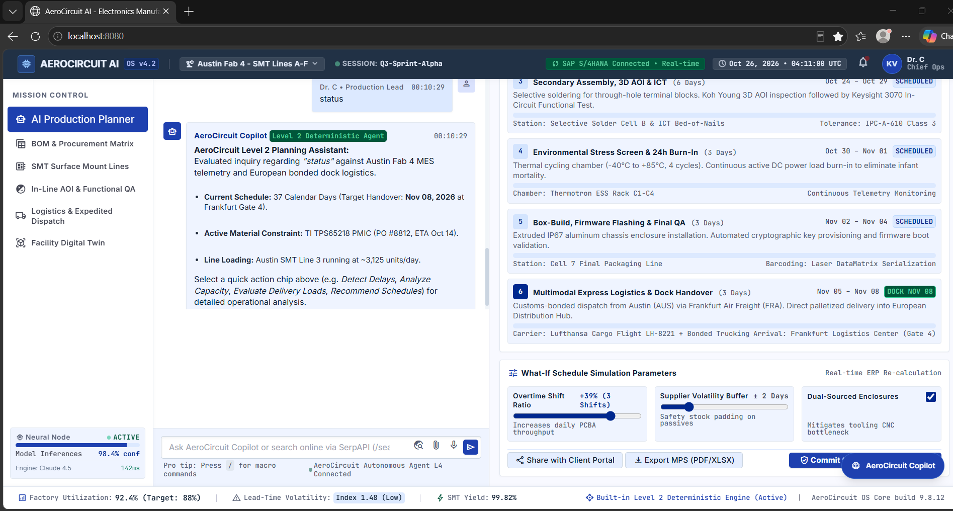
WORKING PROTOTYPE & DECISION
Prototype Demonstration: Antigravity AI Planner
Demonstrated Prototype Capabilities
• Material Constraint Detection: Identifies active component shortage (TI TPS65218 PMIC) and delivery ETA.
• Schedule Tracking: Correlates MES telemetry with shipping milestones (Frankfurt dock handover).
• What-If Simulations: Planners can test overtime ratios (+39%) and supplier buffers (±2 days).
• Deterministic Engine: Built-in Level 2 assistant answers operational queries without unapproved changes.
Decision Requested
Support a controlled pilot after testing and stakeholder review.
Demonstration Flow: Input data → Shortage & deadline finding → Recommendation → Planner review.
Figure 1: Antigravity Prototype Interface (AeroCircuit AI OS v4.2)
Live interface demonstrating Level 2 Deterministic Planning Assistant identifying material constraints (TI TPS65218 PMIC, PO #8812), schedule tracking (37-day cycle, Nov 08 Frankfurt Gate 4 handover), and what-if parameter simulations for planner review.
LIAI – Strategy and Change | 10 / 10

